Slide 1

Classification
Ahmed Tolba
Asmaa Mohy

Slide 2
AGENDA
01
02
k-nearest neighbors
Logistic Regression

Slide 3
What is the meaning of classification?
It is a type of Supervised Learning
Classification is the division of data into several sections
Classification is based on similarity
It is called classification or Logistic Regression

Slide 4
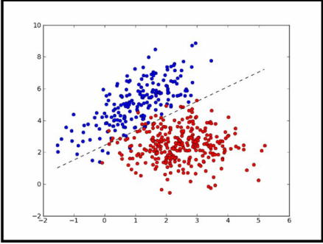
Binary Classification

Slide 5
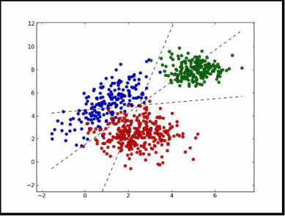
Multiple Classification

Slide 6
ADVANTAGES
Logistic regression is easier to implement, It can easily extend to multiple classes
It is very fast at classifying unknown records.
Logistic regression is less inclined to over-fitting but it can overfit in high dimensional datasets . One may consider Regularization (L1 and L2) techniques to avoid overfitting in these scenarios.

Slide 7
DISADVANTAGES
If the number of rows is lesser than the number of features, Logistic Regression should not be used, otherwise, it may lead to overfitting.
It is tough to obtain complex relationships using logistic regression. More powerful and compact algorithms such as Neural Networks can easily outperform this algorithm.

Slide 8
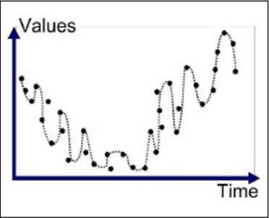
Over-Fitting
It means that the mathematical equation used to adjust all points, which causes an error in the prediction
The reason for its occurrence is
the excessive increase in the data and has no effect
the selection of an inappropriate equation

Slide 9
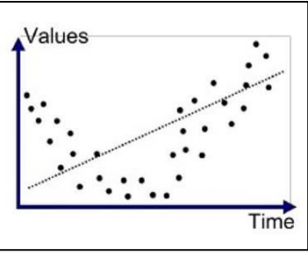
Under-Fitting
The model is unable to learn, and this is that the mathematical equation is weaker than it has the ability to cover points

Slide 10
Over-Fitting & Under-Fitting

Slide 11

Regularization
It is the process of cleaning data with the aim of getting rid of over fitting or under fitting by
1- Adding a lambda will lead to a change in transactions

Slide 12
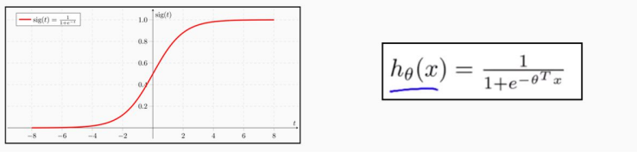
Sigmoid Function
The value of H must be between zero and one where the value of H is the expected value

Slide 13

NOTE:
Let's learn how algorithms work, and we will study the Gradient descent is one of very important , but this is not the one used in the sklearn library.
Optimization techniques used to solve such loss functions....there is a link to what is actually used in sklearn which is actually mix of Optimization functions read only BFGS and L-BFGS
https://github.com/scikit-learn/scikit-learn/blob/4773f3e39d788e734378f32064cf2e5629fbc7aa/sklearn/linear_model/_logistic.py#L1012

Slide 14


Cost-Function
It is called the error equation, and we denote it by the symbol j
IF Y=1
IF Y=0

Slide 15
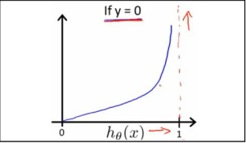
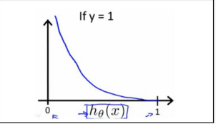
Conditions

Slide 16

Finding Theta
Theta are the future parameters ( X )
The equation is … considered Matrix
Alpha is Coefficient indicating the step amount
m is >> len(Data)

Slide 17
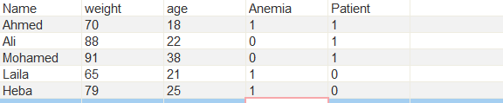
Practical example
We have some data to find out if they are infected or not
We can extract some information from the data
M = 5 ( Len Of Data )
N = 3 ( Future name )
Number of theta = 4 ( N+1)

Slide 18



On its first Iteration,
it creates theta values as random values
Theta matrix is : 4 * 1
X0 = 1
X matrix is : 5 * 4
X Transpose = 4 *5
Y matrix is 5 *1

Slide 19
when multiply X * Theat
X Theta
5 * 4 * 4 * 1 = 5 * 1
Then Subtract X * theta From Y
X * theta - Y = output
5 * 1 - 5*1 = 5 * 1
Then
X Transpose * output new_output
4 * 5 * 5 * 1 = 4 * 1
Alpha = ………
M = 5
Subtract theta from new_output after multiply alpha / m
Repeat this process until you get the perfect values Of Theat And then use
hΘ(x) = g ( Θ0 + Θ1x1 + Θ2x2 + Θ3x3 )

Slide 20
Logistic Regression Model : linear_model.LogisticRegression Parameters : tol The amount of permissible tolerance in the error C regularization random_state Random data max_iter max iteration solver Classification Equation liblinear : small data sag :big data saga :big data Outside attributes coef_ Equation coefficients made through the fitting classes_ future name n_iter_ iteration are be used Methods fit(X, y) Fitting predict(X) predicting score(X, y) score

Slide 21
Knn
Model : neighbors. KNeighborsClassifier
Parameters :
n_neighbors number of neighbors
Weights Forecast calculation method is uniform , distance, or defined function
algorithm Method for calculating the distance for neighbors ( auto , ball_tree , kd_tree , brute)
Methods
fit(X, y) Fitting
predict(X) predicting
score(X, y) score
kneighbors (X) To find the neighbors of a given point

Slide 22
K-nearest neighbors
The k-nearest neighbors ( KNN ) algorithm is a simple, easy-to-implement supervised machine learning algorithm that can be used to solve both classification
It is an algorithm that classifies data according to the distances closest to it.

Slide 23
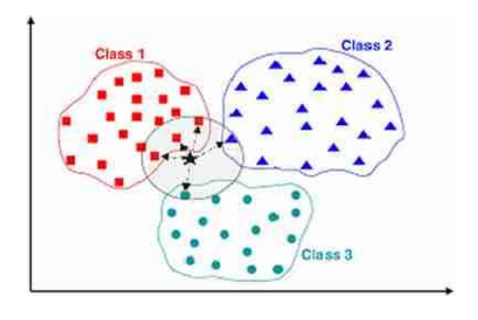
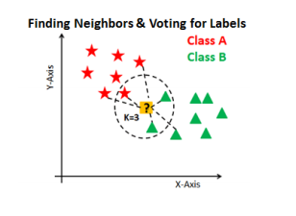
Example
If k = 5
If we have a person and we want to know if he is sick or not , algorithm considers its closest points according to what is determined, and the algorithm tends to the values closest to it. By using Euclidean Algorithm
If k = 6
k It is preferable to be an odd number

Slide 24
ADVANTAGES
No Training Period: KNN is called Lazy Learner
KNN is very easy to implement

Slide 25
DISADVANTAGES
Does not work well with large dataset
Sensitive to noisy data, missing values and outliers
Need feature scaling

Slide 26
Coding With Sklearn

